Slide 1


APPLIED MACHINE LEARNING FOR TEXT ANALYTICS (24ALT3101)
REVIEW – 1
Project Title
Adaptive Reinforcement Learning for Smart Building Energy Management
2420030675-P Dheeraj
2420030653-T Charan
2420030372-DineshKumar
BATCH:20
Department of Computer Science and Engineering
KONERU LAKSHMAIAH EDUCATION FOUNDATION

Slide 2
OUTLINE
Introduction
Objectives
Literature Survey
Proposed Method
Conclusion

Slide 3
Introduction
BACKGROUND & IMPORTANCE
Managing smart buildings effectively requires adaptive control.
Smart buildings generate massive energy-related data using HVAC, smart meters, occupancy sensors, and lighting systems. Traditional energy management often relies on fixed schedules or rule-based control which fails to adapt to dynamic changes in occupancy, weather patterns, and fluctuating electricity prices.
Real-World Application Scope:
• HVAC (Heating, Ventilation, Air Conditioning)
• Smart Lighting & Energy Storage Systems (Battery)
• Demand Response & Flexible Utility Loads

Slide 4
Objectives
OBJECTIVE 1
Reduce Energy Use & Operational Cost
Develop control strategies that substantially reduce building electricity consumption and costs. By dynamically reacting to time-of-use prices, the model learns when to store energy or shift loads to low-tariff periods, achieving highly efficient demand response.
OBJECTIVE 2
Adapt to Dynamic Conditions
Ensure the control system exhibits high adaptability to changing building and environmental conditions. The framework must adjust control settings automatically as occupancy patterns fluctuate, weather changes, and electricity rates adjust in real-time.
OBJECTIVE 3
Optimize Occupant Comfort
Ensure a seamless trade-off between energy conservation and thermal comfort. The system aims to keep average indoor temperature deviations and cumulative comfort violations below acceptable thresholds, preventing extreme indoor fluctuations.

Slide 5
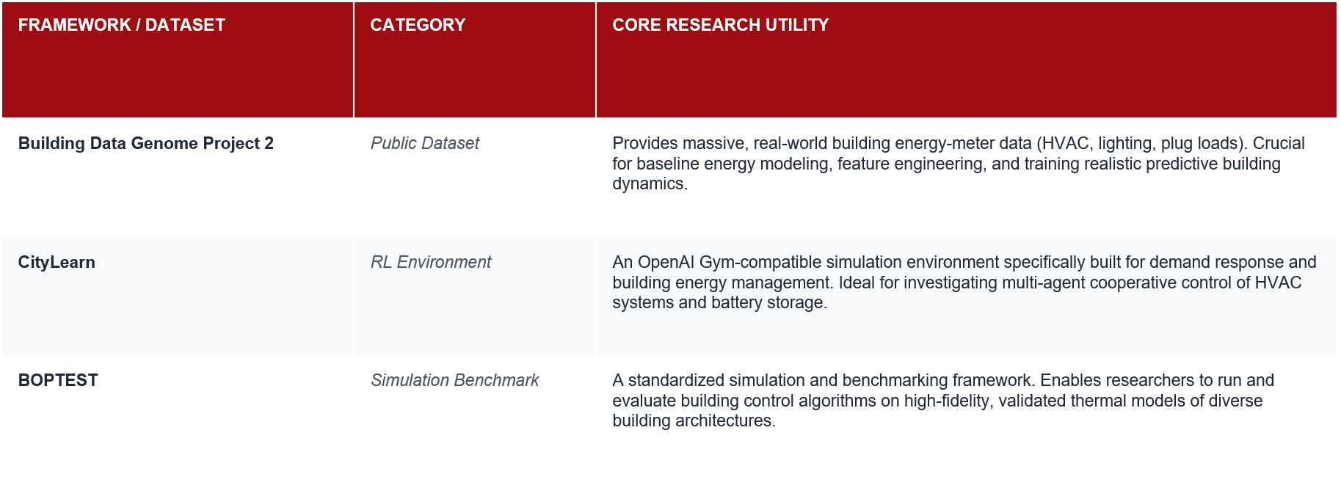
LITERATURE SURVEY
Survey of existing simulation frameworks and standard public datasets utilized for RL smart building research:

Slide 6
PROPOSED METHOD
REINFORCEMENT LEARNING FRAMEWORK
In this architecture, the building acts as the Environment, conditions define the State, and control decisions represent Actions.
1
2
3
4
5
1. INGEST & PREPROCESS
Building Energy Data
Cleans and features raw meter readings, climate files, and dynamic occupancy logs.
2. STATE REPRESENTATION
Environment
Encodes indoor temp, occupant comfort levels, weather, and current utility tariffs.
3. AGENT DECISION
DQN / PPO / DDPG
RL policy processes state to select the most efficient control actions.
4. CONTROL ACTIONS
HVAC / Storage / Lights
Executes HVAC thermostat shifts, light dimming, and battery charge cycles.
5. REWARD FEEDBACK
Multi-Objective Reward
Balances total energy saved against comfort violations as positive reinforcement.

Slide 7
CONCLUSION
REVIEW – 1
SUMMARY OF EXPECTED OUTCOMES
Providing adaptive & intelligent smart building energy management.
Our framework dynamically learns from physical building condition states and selects optimal control actions rather than relying on static rule-based templates. The expected outcome is a severe curtailment of building operational overhead while strictly maintaining human thermal comfort standards.
Key Advancements Over Baseline:
• Dynamic multi-criteria policy optimization.
• Elimination of fixed, rigid rule-based thermostat schedules.
• Inherent robustness to unpredictable real-world occupancy surges.
PERFORMANCE EVALUATION METRICS
• Total Energy Consumption & Savings (%)
Quantifies net kilowatt-hour reduction compared to default rule-based configurations.
• Electricity Cost & Peak Demand Reduction (%)
Measures financial savings derived from shaving peak demand and time-of-use tariff shifting.
• Thermal Comfort Violations
Counts instances of indoor temp deviating from thermal standards to evaluate agent safety bounds.
• Cumulative RL Reward & Policy Convergence
Validates learning stability and efficiency across training epochs in CityLearn / BOPTEST.
07

Slide 8
THANK YOU

